Slide 1
Teechain: Scalable Blockchain Payments using Trusted Execution Environments
GIZEM AKDENIZ
DECEMBER 13 , 2018

Slide 2
BLOCKCHAIN PROTOCOLS
are used to power Bitcoin cryptocurrency
enable fund transfers over a trustless, decentralized and global network .
robust and secure
greatest weakness : performance limited by the rate and latency

Slide 3
BITCOIN
digital crytocurrency
bitcoin adress associated with public/private keypair
Bitcoin transactions: pieces of info conveying which funds are to be transferred between which Bitcoin addresses.
Transaction inputs : unspent transaction output(UTXOs)
script : specified within each UTXO , to prove ownership of the UTXO
each peer (or node ) -> updates a copy of the (append-only) bitcoin blockchain
Performance limitation : only a handful of transactions per second and requires waiting 10’s of minutes before providing the transaction confirmation

Slide 4
TEE
CPU safeguards the confidentiality and integrity of code
allow code to run in a trusted environment called an enclave
Code and Memory Isolation
Remote Attestation

Slide 5
TEECHAIN
Definition : a payment channel and multi-hop payment protocol that supports practical , efficient and secure off-blockchain fund transfers .
goal : to overcome the limitations of underlying blockchain protocol

Slide 6
Approach
Runs inside each party’s TEE
Exploits TEEs to enforce correct operation of mutually distrusting parties during off-chain fund exchanges
Protocol to route payments across multiple payment channels (payment chains),

Slide 7
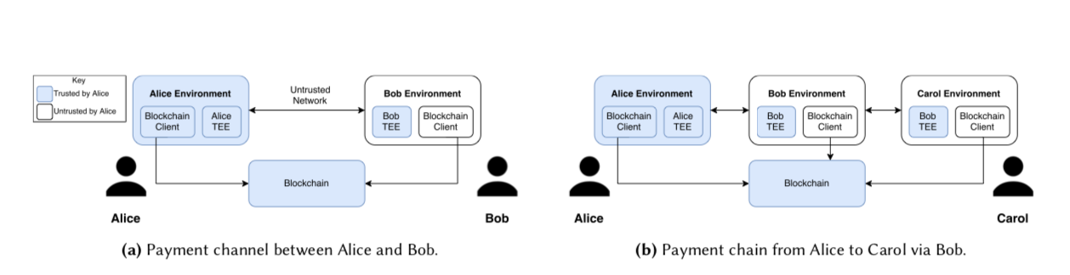
Model and Assumptions
mutually distrusting parties using a blockchain-based cryptocurrency to exchange funds
potentially malicious parties
parties are connected via a network, with some parties behind firewalls or network address translation (NAT).

Slide 8
Interaction with the blockchain:
(i) when funds are deposited into the network
(ii) when funds are released from the network
(iii) when a new deposit is approved and assigned to a channel
(iv) when payment channels are terminated
no direct way of verifying transactions !

Slide 9
Payment channels
bidirectional payment channels between TEEs with direct network connectivity
enables two participants to exchange funds (without blockchain interaction)
when a channel termination occurs -> generating only a single blockchain transaction for the final state of the channel

Slide 10
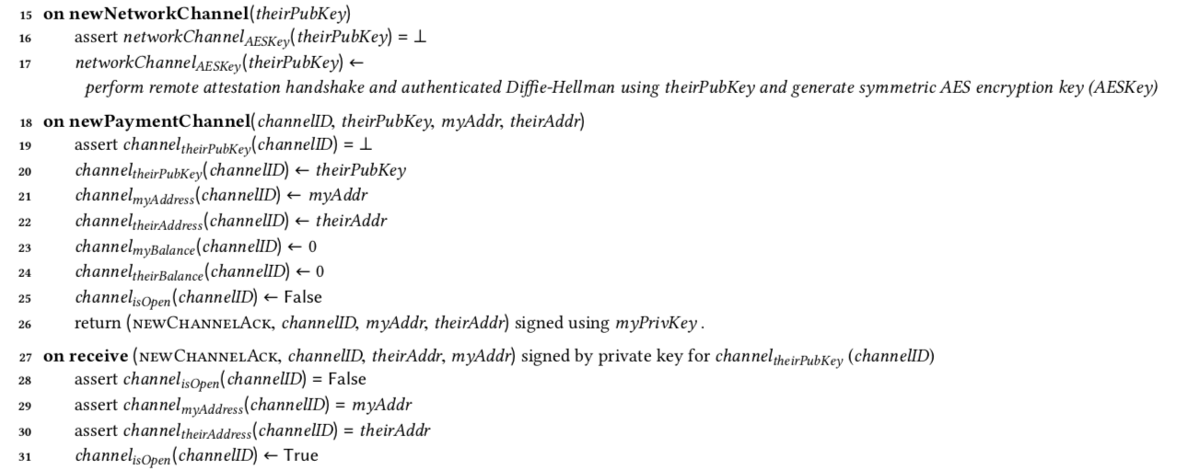
Protocol
a secure network channel is established between two TEEs (newNetworkChannel, line 15)
Both participants provide their TEEs with the remote public key and a cryptocurrency settlement address (newPayChannel, line 18).
agree on a unique channelID
The TEEs then associate this information with the channel and create a signed acknowledgement message (line 26), opening the channel (line 27).

Slide 11
Deposits
deposits : transaction outputs that
have been paid into a bitcoin address that is held by a Teechain TEE, meaning that the addresses’ private keys are only known to the TEE, and that
have been placed onto the blockchain
only the owning TEE is ever able to release those deposits again by generating a corresponding spending transaction.
TEE allows funds to be associated/dissociated with payment channels at runtime.

Slide 12
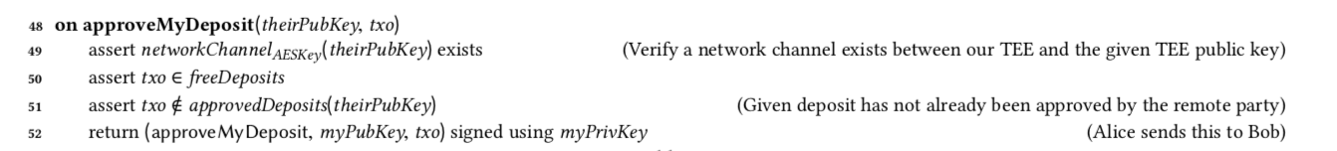
deposit has actually been placed onto the blockchain
command approveMyDeposit , approveMyDeposit request to the remote party.
must only be approved once for each pair of Teechain participants
can be associated with any payment channel between the pair of TEEs
can be performed at any time during protocol execution
Deposit approval

Slide 13
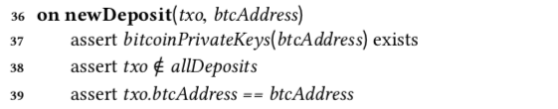
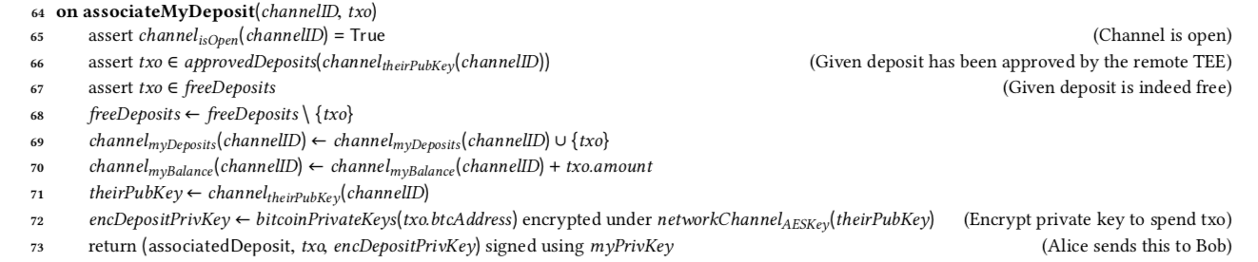
Deposit Association
Command associateMyDeposit
New deposits can be added at any time (newDeposit, line 36).
The corresponding private keys to spend deposits are stored in the TEEs , allowing the funds to be released later (releaseDeposit, line 42).
Before a deposit can be associated with a channel, the remote party must approve it (approveMyDeposit, line 48).
locates the corresponding Bitcoin private key that can spend the txo , encrypts it for the channel forwards it

Slide 14
Deposit Dissociation
command dissociateDeposit
providing a channel ID and the deposit to dissociate
Verifiying whether dissociation is permissible, i.e. whether the value of the dissociated deposit does not exceed her current channel balance.
may be performed at any point in time while the payment channel is open.

Slide 15
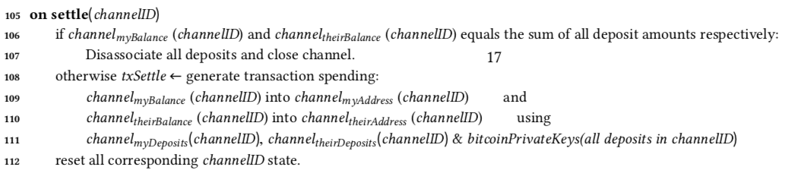
Payment Channel Settlement
Either party may settle the channel according to its current state at any point in time.
command settle
no payments having been made :
channel -> terminated
deposits -> disassociated from the channel
2) sends the balances of the parties to their settlement addresses using all the deposits currently associated with the channel, and the corresponding private keys to spend from those deposits.

Slide 16
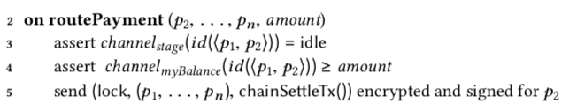
Payment Routing
a protocol to route payments across multiple Teechain payment channels
all nodes of the payment chain have been securely attested
command routePayment :
the amount of money to be sent and
the public keys of all nodes along the path
Stages:
1. LOCK
2.SIGN
3.PROMISEA
4.PROMISEB
5.UPDATE
6.RELEASE

Slide 17
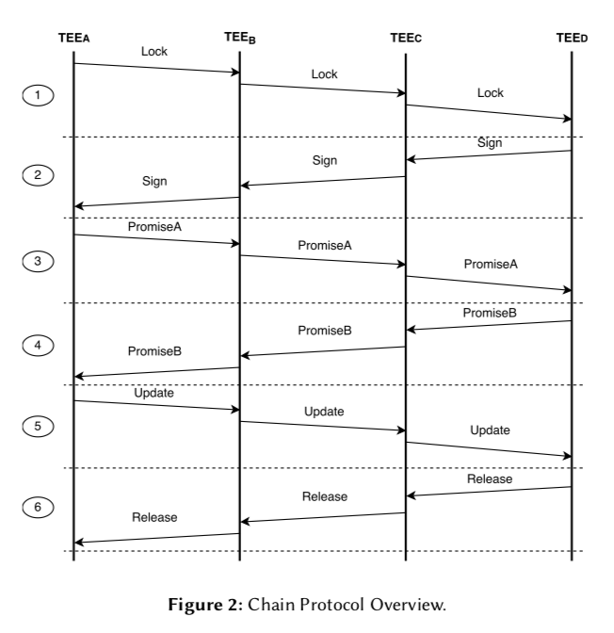
1 .LOCK
to lock the states of all payment channels in the payment chain
the chain settlement transaction chainSettleTx -> that settles the state of all channels in the payment chain according to the post-payment state
2. SIGN
Signing the settlement transaction
chainSettleTx -> signedChainSettleTx
3. PROMISE A
Promise to not settle pre-payment
4. PROMISEB
Promise to correctly settle post-payment
5. UPDATE
State Update
6. RELEASE
Lock release

Slide 18
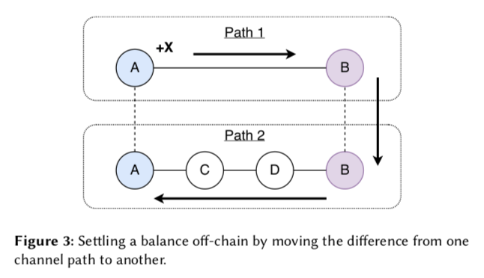
Off-chain Channel Termination
Advantage:
the funds become available immediately and can be used for future payments
reduces the amount of transactions that must be placed onto the blockchain
!! Teechain is able to terminate channels off-chain if two nodes of the Teechain network share at least two payment paths. !!

Slide 19
Fault Tolerance
To avoid permanent loss of funds:
1. Persistent Storage
2. TEE State Replication: Backup Chains

Slide 20
Performance Evaluation
throughput and latency of payment channels and payment chains are measured
Teechain nodes use either persistent storage or chain replication (to understand the impact of fault tolerance)
throughput -> maximum number of transactions sent on a channel or a chain per second.
measuring the throughput -> send x payments to the counterparty and measure the time ∆t from the initiation of the first payment until the receipt of the x-th acknowledgement.
latency -> the time measured from the moment a payment is issued until the acknowledgement for that payment is received.

Slide 21
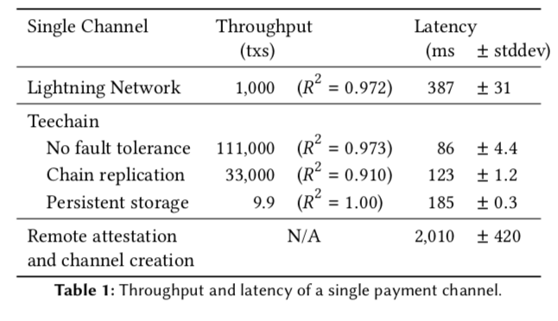
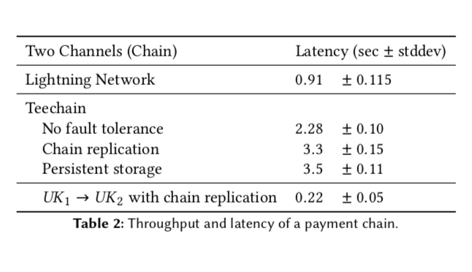
three step payment chain : UK1 -> US -> UK2
Teechain : requires 3 RR
LN : requires 1.5 RR
for chain replication , persistent storage : additional RRs

Slide 22
Thank you for your attention!

