Slide 1
Slalom: Fast, Verifiable and Private Execution of Neural Networks in Trusted Hardware
Kriti shreshtha

Slide 2
What are neural networks
Why do we need it?
3 main motivating scenarios
How TEE offers a solution
Approach
Setting and Assumption
Integrity and Privacy
Slalom
Quantization
Input Privacy
Implementation
Future Work

Slide 3
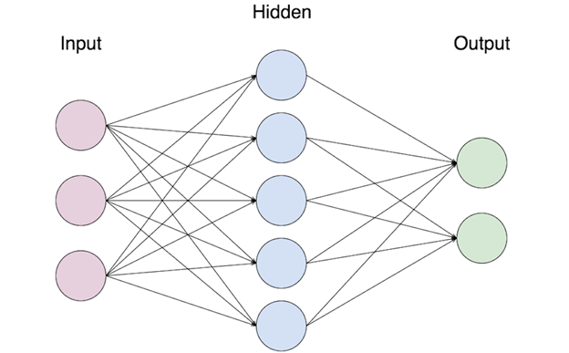
Neural Networks
Vaguely inspired by the biological network of neurons.
It is a type of machine learning that models itself after human brain.

Slide 4
Why do we need it?
Because Machine learning it getting applied to security critical and sensitive domains to make sensitive decisions
Growth in both cloud offerings and software stack complexity widens the attack surface for ML applications
Need for integrity and privacy guarantees for the ML computations running in untrusted environment
Raises questions about the trust put in the execution environment where ML models are run

Slide 5
3 Main motivating scenarios
Outsourced ML : Users must trust the cloud services (to which the ML computations are outsourced) for correct execution. Cloud may also learn the sensitive data provided by the client.
Federated Learning : Centralized aggregation of model updates trained on user end-devices enables efficient distributed training. Privacy can be achieved but integrity can not be assured.
Infected Hosts : The software and hardware stack in both local and outsourced settings, has to be trusted to be malware free

Slide 6
How TEE offers a solution
It could attest to a remote client that it executed a given ML model correctly in the cloud
collect data from trusted sensors and attest to the central server that model updates were correctly computed
run sensitive ML computations in isolation from a possibly infected host
But, the isolation guarantees of TEEs also come at a price in performance

Slide 7
Approach
We try to efficiently leverage TEEs for secure machine learning computations
Wherein a Deep Neural Network (DNN) execution is partially outsourced from a trusted processor to a co-located, untrusted but faster device
Slalom : a framework for efficient DNN evaluations in any trusted execution environment

Slide 8
Setting and Assumption
P_{U} and P_{T} are two untrusted and trusted processors respectively
a user U delegates the execution of a DNN F(x) : X → Y to the trusted processor P_{T}
P_{T} might guarantee two properties i.e. Privacy and Integrity
The problem we consider is that of efficiently evaluating the DNN F in P_{T} , by selectively leveraging the fast but untrusted processor P_{U} , without having to sacrifice integrity or privacy.

Slide 9
Integrity and Privacy
For integrity, we use Freivald’s algorithm : Matrix multiplication, the main computational bottleneck in DNNs, admits for a simple and concretely efficient secure delegation scheme
Blinding : Input privacy for outsourcing a linear function could be achieved using cryptographic techniques, but the overhead is prohibitive in our setting. We instead propose a two-stage approach in which the trusted processor computes linear layers on random inputs in an offline phase, and uses the obtained results to blind (i.e., encrypt) a user’s inputs in a later on-line phase.

Slide 10
Slalom
Inputs and weights are quantized and embedded in a field F
Linear layers are outsourced to an untrusted device and verified
Inputs of linear layers can be blinded with random masks to guarantee privacy of the DNN’s input

Slide 11
Quantization
For integrity and privacy (Freivald’s algorithm and blinding) we need to work over a finite field, so floating point is inconvenient
Therefore, all inputs and weights of a DNN are quantized so as to operate over integers

Slide 12
Input Privacy
To hide user inputs, we use precomputed blinding factors for each outsourced computation
The trusted processor P_{T} uses a cryptographic Pseudorandom Number Generator (PRNG) to generate blinding factors
The precomputed “unblinding factors” are encrypted and stored in untrusted memory or disk
In the online phase, P_{T} regenerates the blinding factors using the same PRNG seed and blinds the inputs sent to the untrusted processor
Upon receiving a blinded result, P_{T} loads, decrypts and applies the precomputed unblinding factors

Slide 13
Implementation
A lightweight C++ library is designed for feed-forward networks based on Eigen, a linear-algebra library which TensorFlow uses as a CPU backend
For integrity, Freivald’s check is applied twice to every layer
For privacy AES-CTR and AES-GCM are used to generate, encrypt and authenticate blinding factors
For two canonical DNNs, VGG16 and MobileNet, we obtain 20× and 6× increases in throughput for verifiable inference, and 10× and 3.5× for verifiable and private inference
Slalom can work with any trusted execution environment. linear DNN layers can be reliably outsourced to boost inference throughput without compromising integrity and even privacy

Slide 14
Future work
The techniques described for verifiable outsourcing of DNN forward operations could also be applied to DNN training. Indeed, the backward pass in a DNN essentially makes use of similar linear operators as in the forward pass, and could thus be verified using Freivald’s algorithm.

