Slide 1
Shielding applications from an untrusted cloud with Haven
Based on the paper ‘’ Shielding applications from an untrusted cloud with Haven’’ by Andrew Baumann, Marcus Peinado, and Galen Hunt, Microsoft Research.

Slide 2
Content
Introduction
Motivation
Current Approaches
Objective
System
Limitations and Performance
Future Work
Conclusion

Slide 3
Motivation
Todays clouds use a security model that aims only to protect the privileged code (of the cloud provider) from untrusted code. (user’s VM) What does this mean to the user?
The user must trust:
Provider’s Software
Provider’s Staff
Law Enforcement Bodies

Slide 4
Current Approaches
Hardware Security Modules
Temper proof Hardware to protect secrets
Support a range of cryptographic functions
Expensive
Do not usually run general-purpose applications
Trusted hypervisors
Protection of an application from malicious OS
Cannot protect against a hypervisor controlled by malicious or comprimised cloud provider

Slide 5
Objective
Secure execution of unmodiﬁed legacy applications on a commodity OS and commodity hardware
‘’… level of trust equivalent to user operating their own hardware in a locked cage at a colocation facility’’
What does that mean?
Limiting the cloud provider to offering raw resources
Just like the colocation provider
Can deny service but cannot observe or modify any user data
=> Shielded Execution

Slide 6
System
Security overview
Background
Design
Implementation

Slide 7
Security Overview
Shielded execution
Isolated execution
Protecting specific code from rest of the system
However naive isolated programs are vulnerable
Guarantees Confidentiality (like a ‘’Black Box’’) and Integrity
Thread Model and Assumptions
Assuming CPU itself is implemented correctly
Adversary has full control beyond the physical package of CPU
and entire software stack
Do not considering side-channel attacks

Slide 8
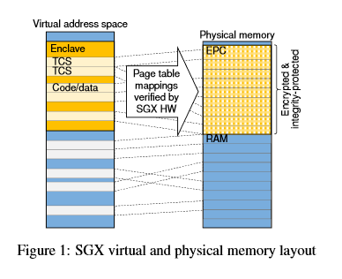
Background
Intel SGX
Memory protection
Attestation
Enclave entry and exit
Dynamic memory allocation
DrawBridge
Low-overhead Sandboxing
Picoprocess and LibOS

Slide 9
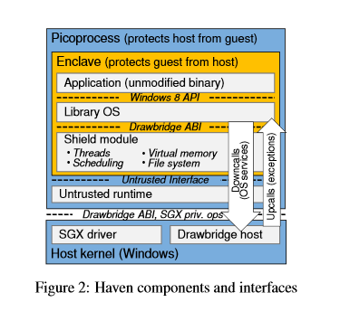
Design
Challenges
Malicious host OS
Iago Attacks
Unmodified Binaries
Architecture
Enclave within Drawbridge picoprocess
Contains entire application and LibOS
Augmented with 2 layers
Shield Module
Untrusted runtime

Slide 10
Shield Module
Trusted Computing base
Protecing LibOS and application from Iago attacks.
Services
Virtual memory
Storage
Threads and synchronisation

Slide 11
Untrusted interface
‘’the guest controls policy for virtual resources, while the host manages policy only for physical resources.’’
Mutual distrust between Host/Guest
Limits host to only physical resource allocations
Untrusted runtime
Bootstrap and glue code
Untrusted both ways
Creating enclave, loading shield, forwarding calls

Slide 12
Implementation
SGX support to host OS
by writing a driver and changes on kernel
Modifications on host kernel to enable efficient mapping
Support for debugging an enclave using SGX debug mechanism
Minor modifications on LibOS

Slide 13
Deployment and attestation
Constructing a disk image and encrypting it
Encrypted VHD and shield binary are sent to the cloud provider
Cloud provider establishes a picoprocess and loads untrusted runtime
After initialisation the shield generates a public/private key pair and uses it to establish a network connection with user
If everything is loaded correctly the user encrypts the VHD key using the public key and sends it back to shield

Slide 14
Limitations and performance
SGX Limitations
Performance evaluation

Slide 15
SGX limitations
Dynamic memory allocation
Exception handling
Not all exception causes are reported to the enclave
Permitted instructions
SGX dissalows in-enclave execution of instructions that are commonly encountered in LibOS and application boundaries effecting performance
Thread-local storage

Slide 16
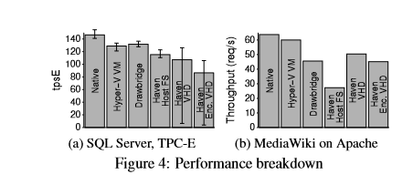
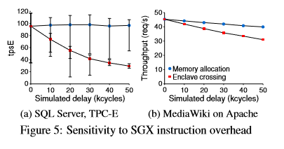
Performance Evaluation
Comparing Haven’s performance to alternative host environments (which do not provide shielded execution)
Summary: Haven’s performance penalty vs. a VM is 31-54%
Acceptable overheads, in return for not needing to trust the cloud

Slide 17
Future work
Storage rollback
Cannot prevent the attack: ‘’the enclave is terminated, and its in-memory state is lost
Plan to communicate only on ‘’critical’’ writes
Untrusted time
Malicious host may lie about time or signal timeouts
Plan to ensure the clock always runs forward
And using cycle counter as an alternative clock
Cloud management
Haven prevents host’s ability to capture and recreate guest state
Plan to implement checkpoints and resume by capturing state to an encrypted image

Slide 18
Conclusion
Cloud platforms offer many advantages but the provider must be trusted with full access to user data.
Implementing a shielded execution eliminates this risk
Bringing us closer to ‘’utility computing’’ for the cloud
Utility provies resources
But has no acess to user data

Slide 19
Thank you
Yanki Kurtcan

